Slide 1
Using QGIS
to process
raster images
Robert Catherman

Slide 2
Global Forest Change
University of Maryland project
Question: what areas globally have gained or lost forest coverage between 2000 and 2013?
Resources: several UM professors, assisted by USGS, processed on Google server farm, assisted by PhD candidate students of UM
http://earthenginepartners.appspot.com/science-2013-global-forest

Slide 3
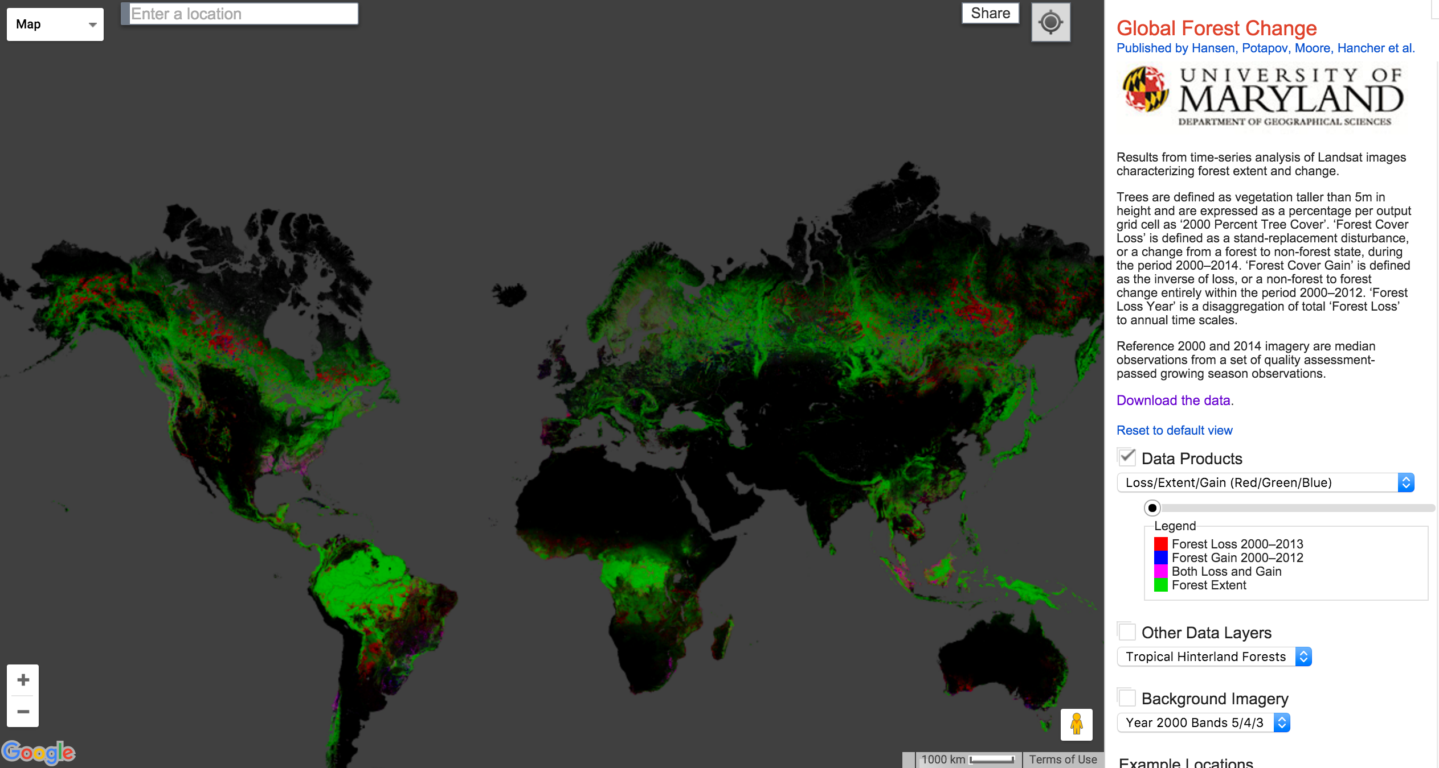

Slide 4
My project
Goal: Replicate the analysis processes of UM
choose a small study area
define the workflow to process Landsat images
execute the workflow
compare the results

Slide 5
Resources
Landsat images - downloaded
one average GIS practitioner (me)
one undergrad UW student assistant
QGIS open source software
Windows laptop

Slide 6
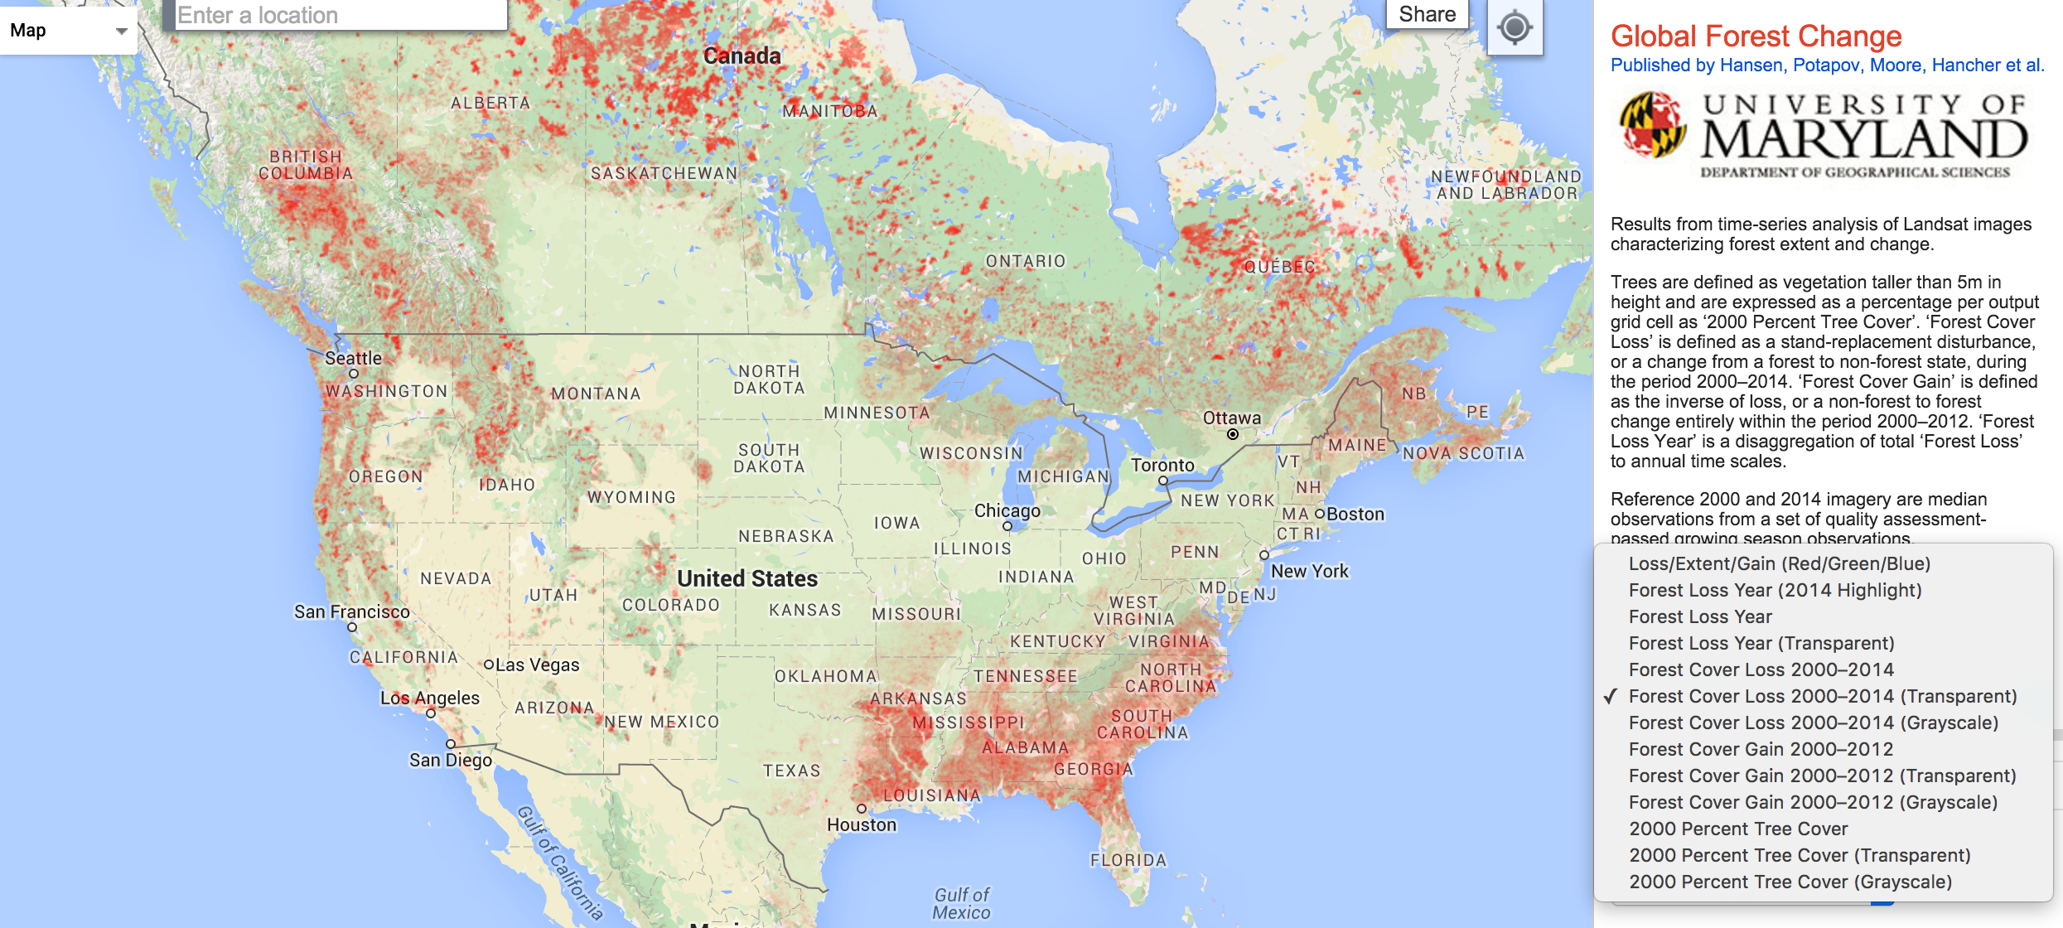

Slide 7
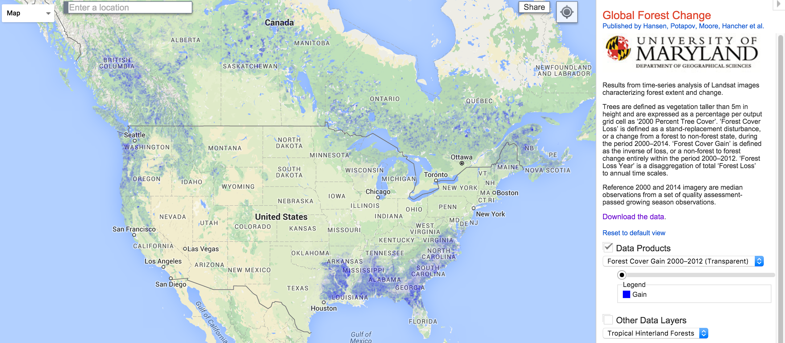

Slide 8
Study Area
Redmond, WA neighborhood where forest had been cut down and houses built

Slide 9
vector shape files - points, lines, polygons
remote sensing - example - digital camera
raster - grid / resolution / pixel values
Landsat raster images from USGS website
1970s - present
purpose - land use / land coverage
resolution 30 m x 30 m
sensor spectrums - pixel values

Slide 10
Download Landsat 8 Image
Locate image on USGS website
Select location, date, max cloud cover
Download compressed file > 1 gig
Uncompress to 12 images bands (next slide)
Image coverage 100 x 100 miles

Slide 11
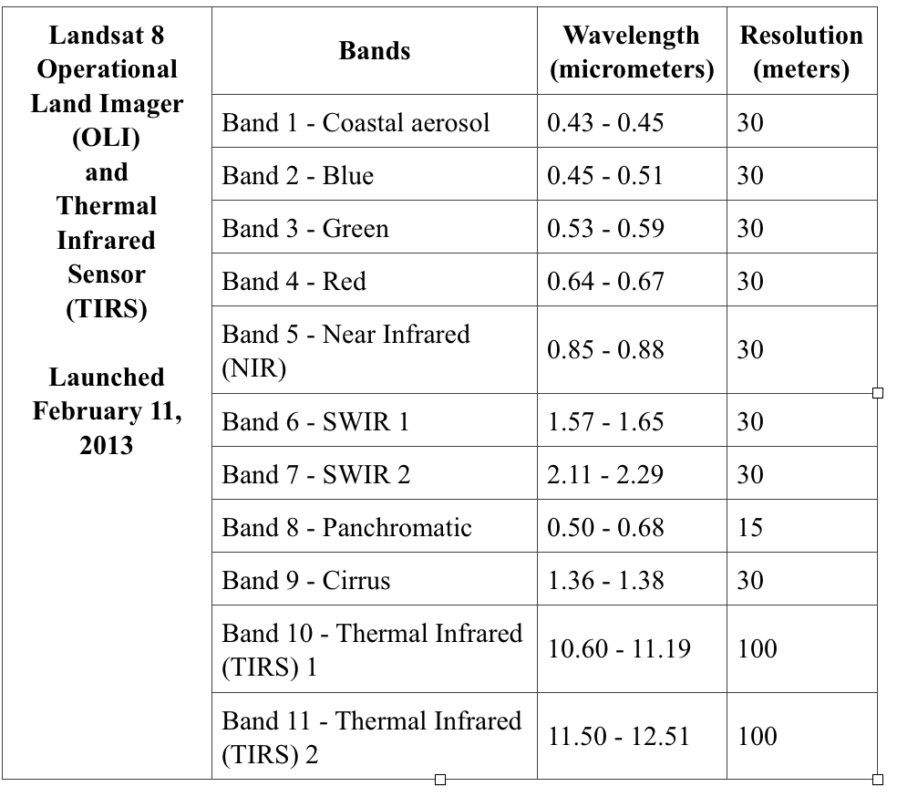

Slide 12
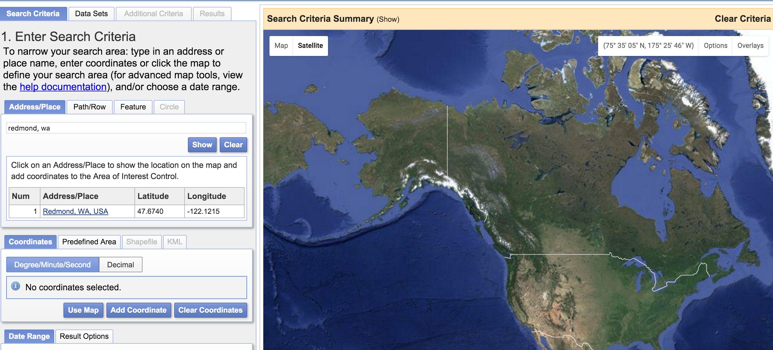
http://earthexplorer.usgs.gov/
http://earthexplorer.usgs.gov/

Slide 13
Load rasters into QGIS
Landsat 7 - bands 3 and 4
Landsat 8 - bands 4 and 5
Crop rasters using KML study area
Cleanup

Slide 14
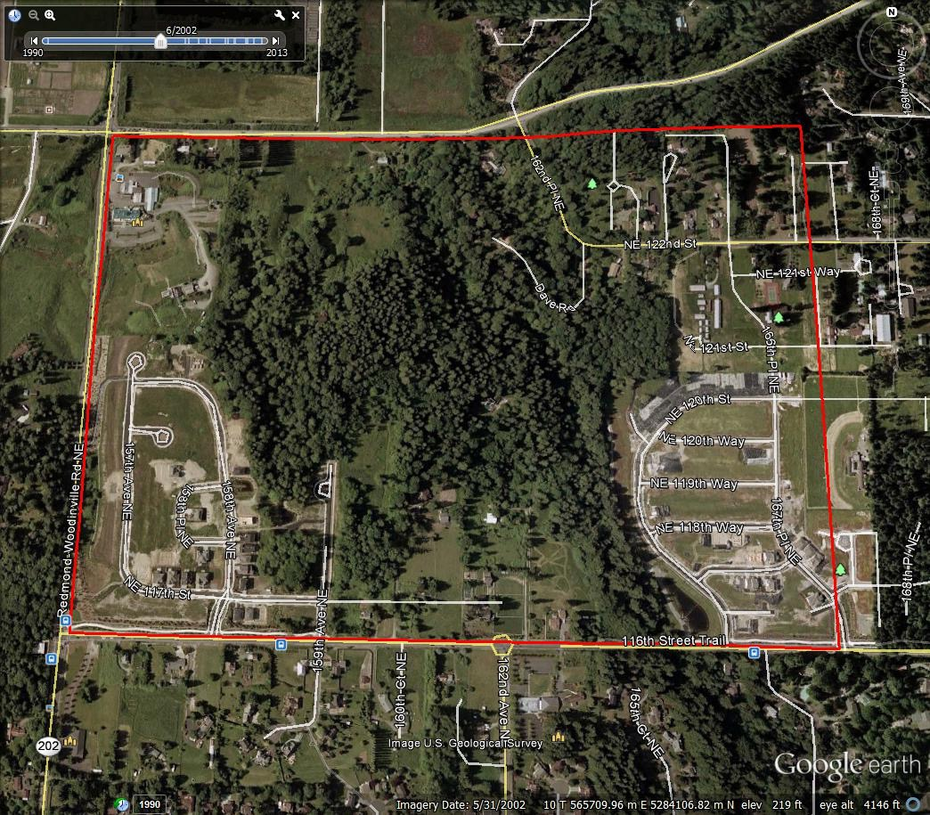
Define our study area and create KML file to import into QGIS

Slide 15
Normalized Difference Vegetation Index
images from Landsat satellites
Channel 3 is in the visible red-light region
chlorophyll absorbs incoming sunlight.
Channel 4 is in the near-infrared region
plant's spongy mesophyll leaf structure creates considerable reflectance
As a result, vigorously growing healthy vegetation has low red-light reflectance and high near-infrared reflectance, and hence, high NDVI values.

Slide 16
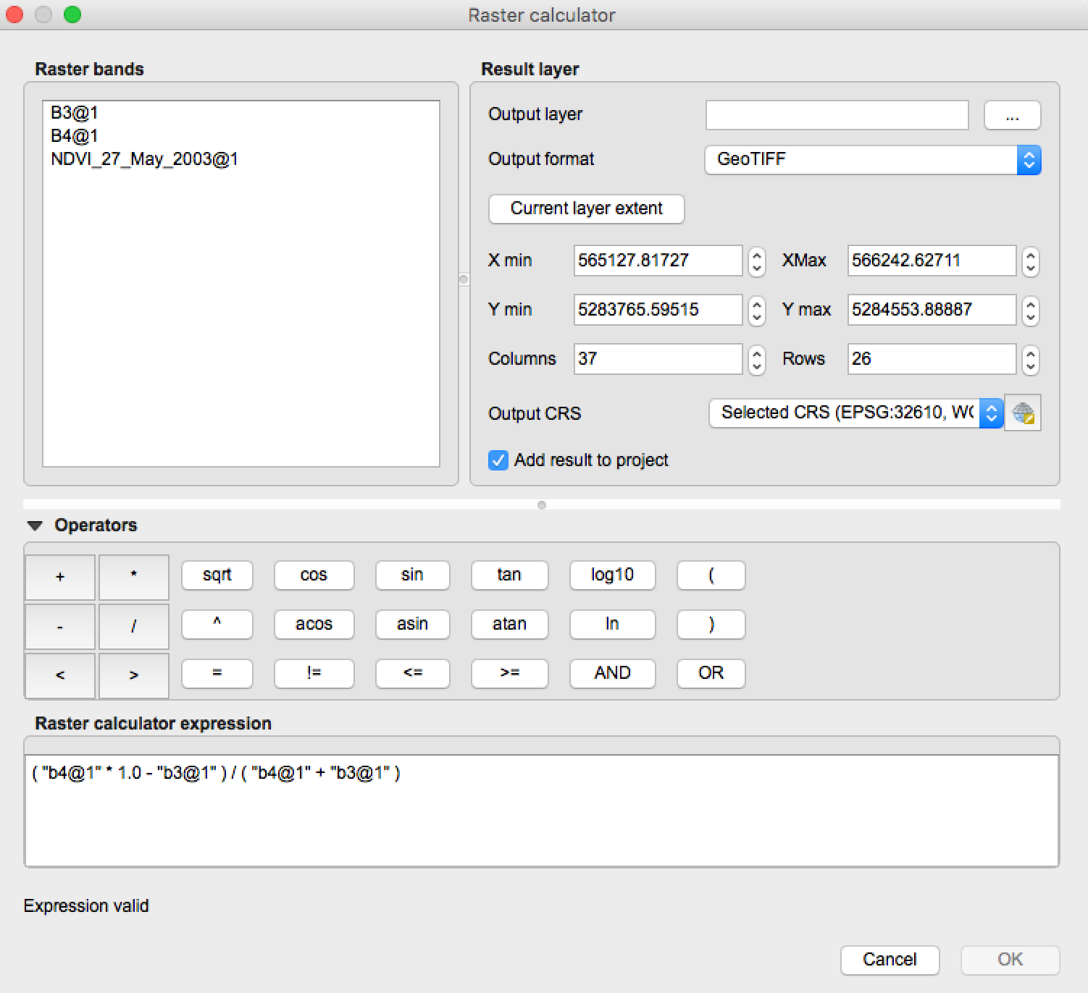

Slide 17
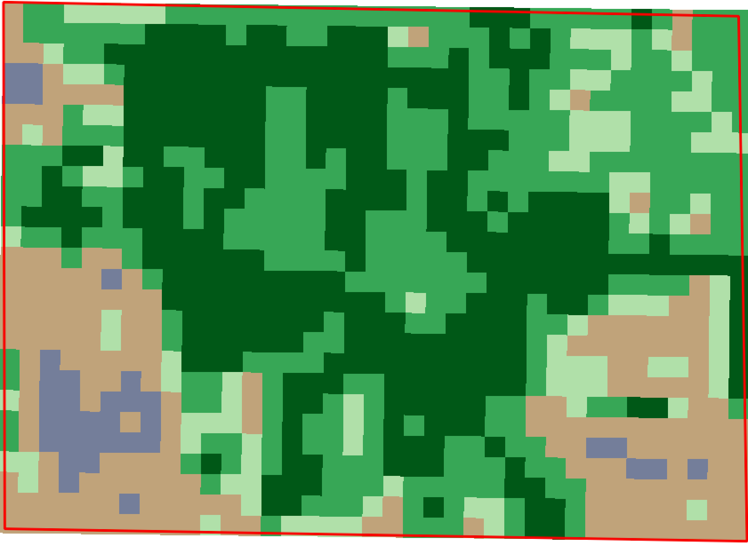

Slide 18
2002

Slide 19
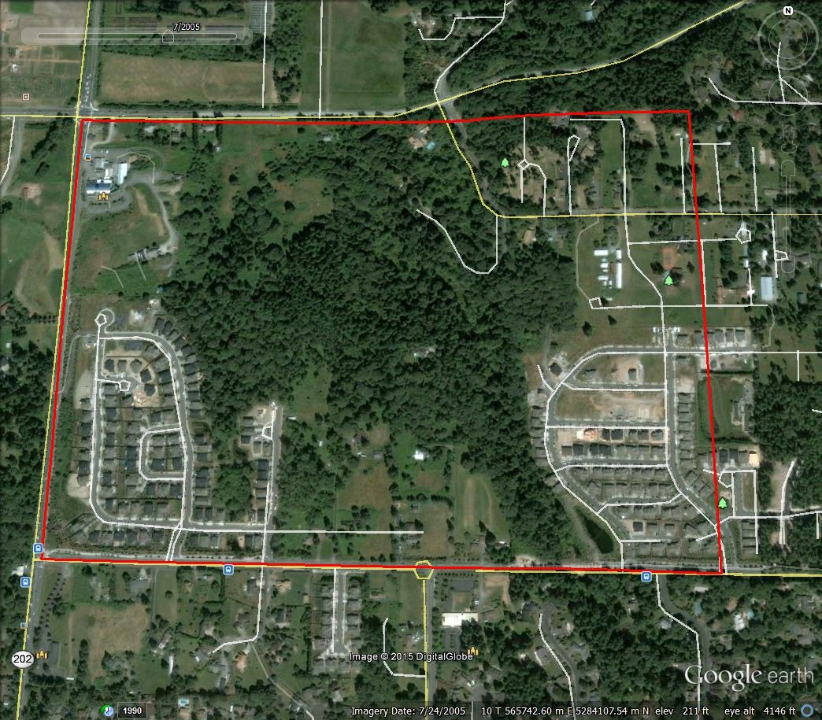
2005

Slide 20
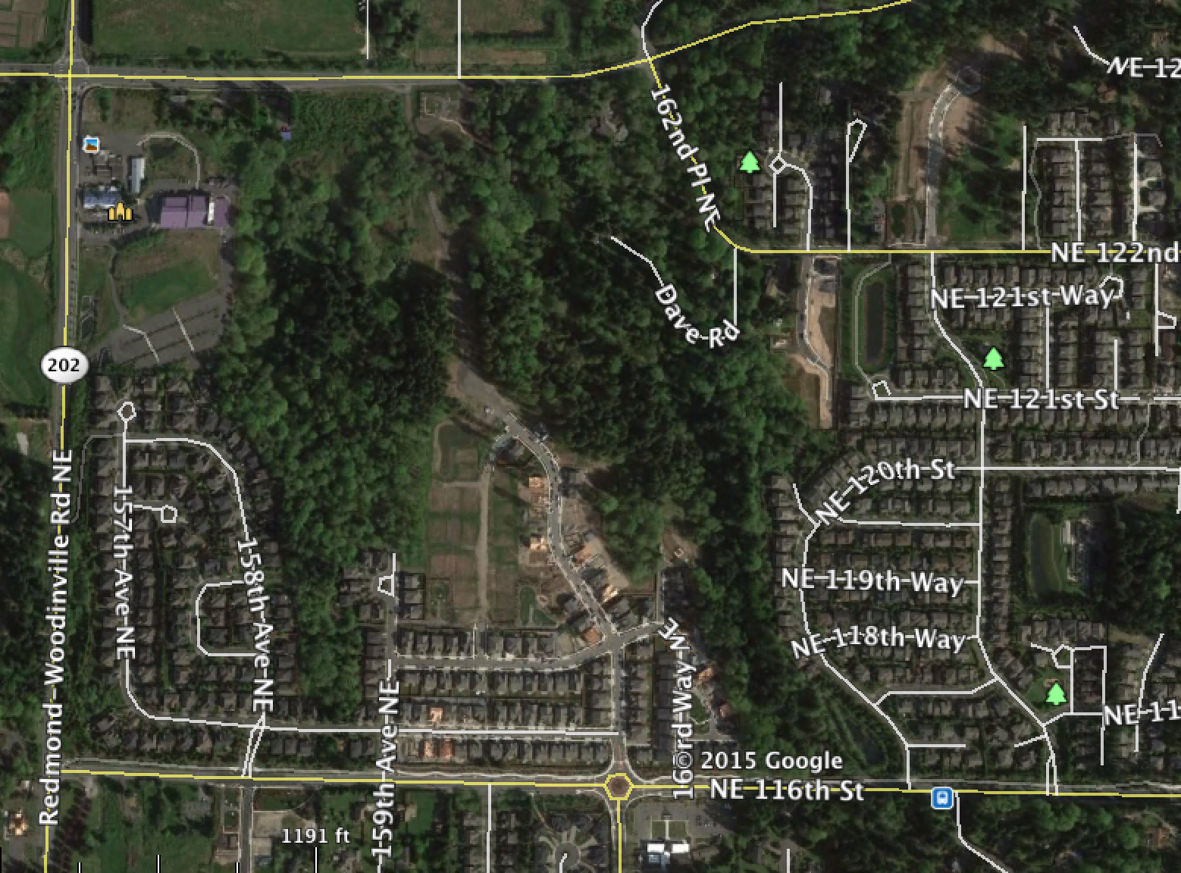
2015

Slide 21
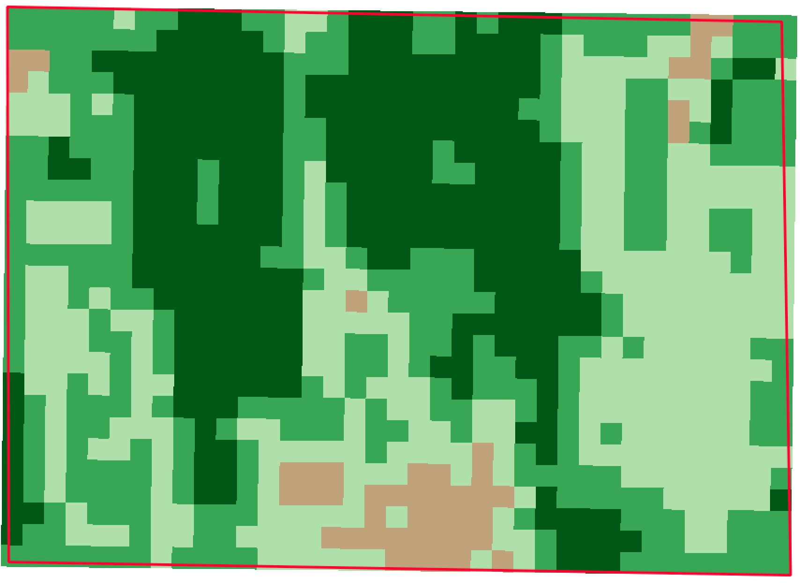
2002
2014

Slide 22
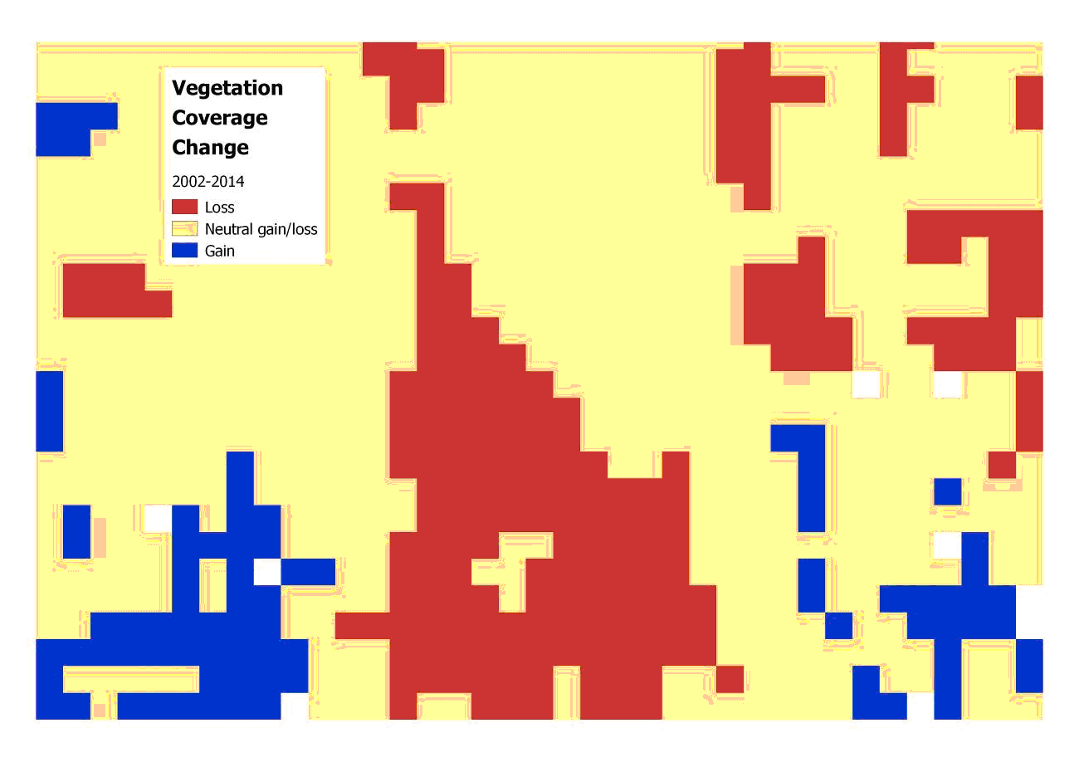
Study area NDVI analysis of vegetation gain and loss (2002-2014)

Slide 23
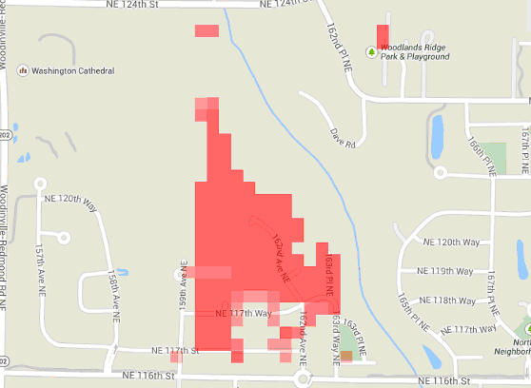
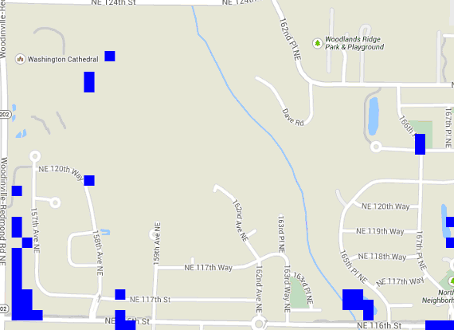
University of Maryland Global Forest Coverage Change
Forest Coverage Loss (2000-2013)
Forest Coverage Gain (2000-2013)

Slide 24
Interpretation
:
Comparing our NDVI analysis above with the upper image of UM GFCC forest gain image, we see good agreement between our shape and area of coverage of “loss”. There is less agreement between the two analyses for “gain”. There are several reasons for this greater variance.
It is important to note the reasons why the two images might differ. First, the dates of images used to the produce the analysis are slightly different. University of Maryland used the date range of 2000-2013 and we used a date range of 2002-2014. A second reason for a variance is that the UM analysis was of “forest coverage” with “forest” being defined as trees over 5 meters in height. Our NDVI analysis was more general – we analyzed all vegetation not just forest.

